Slide 1
Pivott
Pick it, click it, flip it!

Slide 2
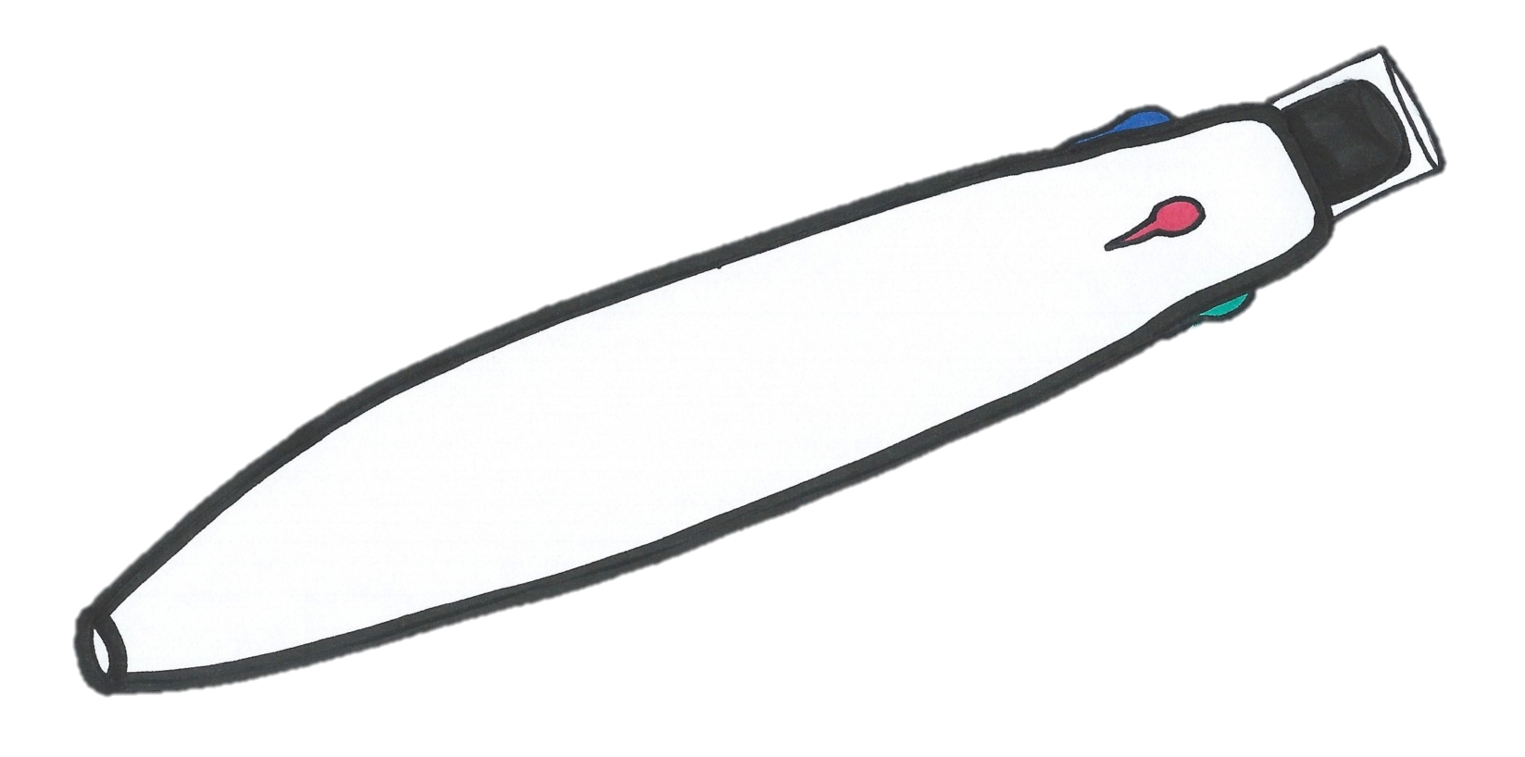
Erase with a flip!
Top off with a cap!
Pivott
Pick it, click it, flip it!
4 colors to pick from!
Pivott Marker

Slide 3

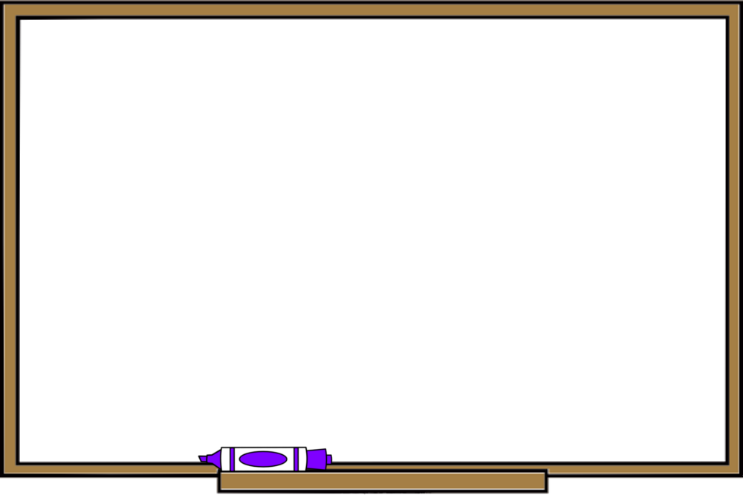

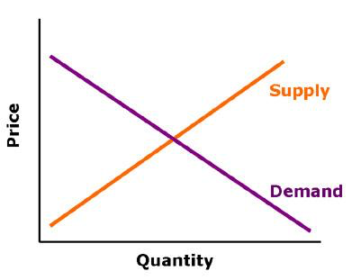




Our Inspiration
Pivott Marker

Slide 4
Target Market
Teachers
Business Men/Women
Artists
Designers
Pivott Marker

Slide 5
Finances
Cost to produce: $2
Product Price: $4.99
Profit Margin: 60%
Market Share: 5.8%

Slide 6
Finances
Pivott Marker

Slide 7
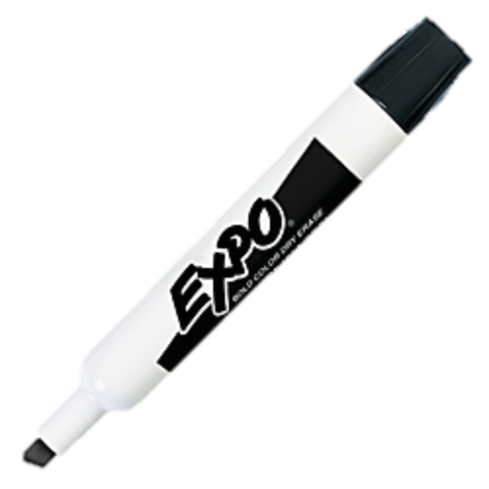
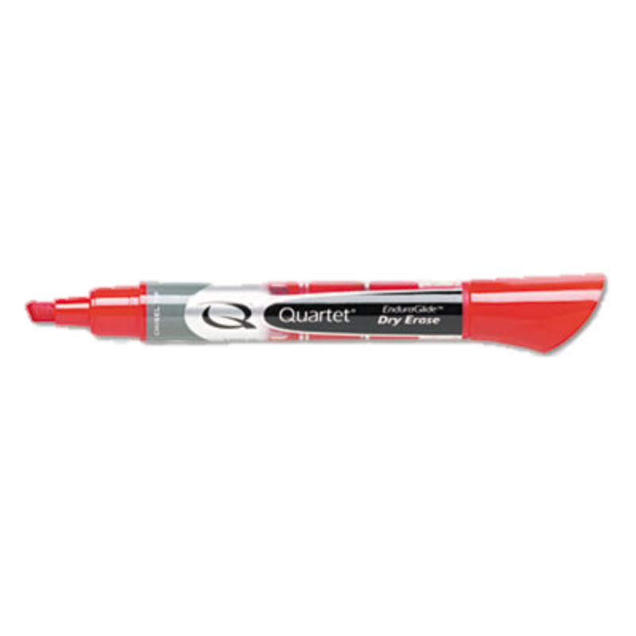
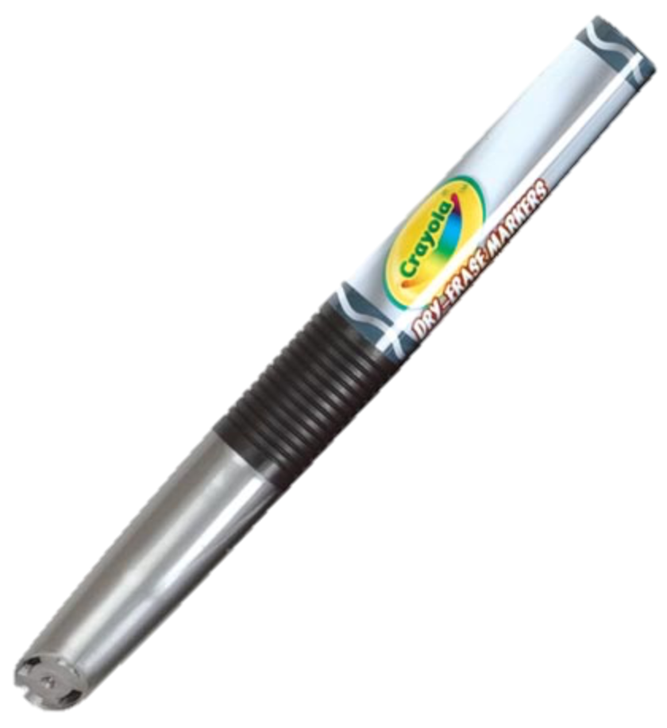
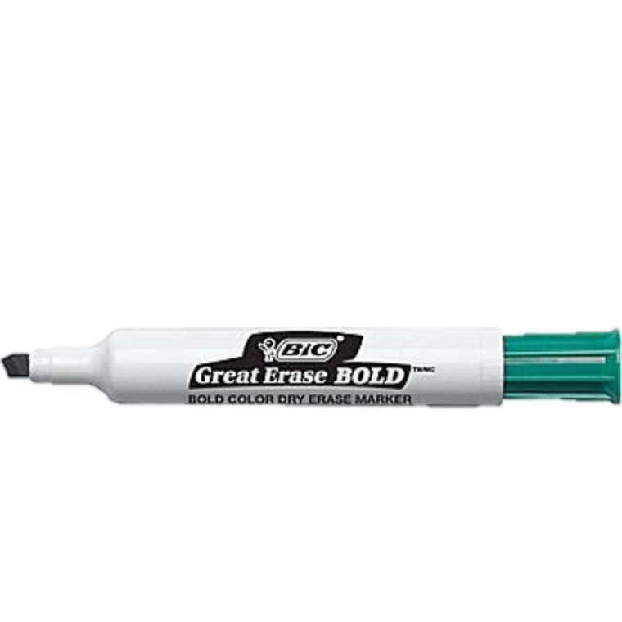
Competition
1984
1985
1987
Pivott Marker
1992

Slide 8


Why us?
Low odor
Washable
Recyclable
Last 20% longer
Pivott Marker

Slide 9


Our Pride
7% profit
Pivott Marker

Slide 10


Pivott
Pick it, click it, flip it!
Contact us!
Website: www.pivottmarker.com
Email: customersupport@pivott.com
Phone: 1(800) CLICK-IT
Follow Us!
@PivottMarker
Notes:
14,000 first year, 34,000 second year, 39,000 third year
Profit $32,000 $102,000
Secure 15% market in America
Rent small factory in Europe
Start new line of products according to needs
Buy own factory and advertise

